Slide 1
Information Security - 2
Topic: Architectural Aid to Secure Systems Engineering
V. Kamakoti
RISE LAB, Department of Computer Science and Engineering
IIT Madras
Session – 1: need for secure systems

Slide 2
Course Structure
Information Security – 1
dealt with the security related expectations of User Community
This course shall address
The role of Architecture in building Secure Systems
Demystifying the Features in existing architectures included for handling Security.
Lab intensive course
Linux Laptop
Follow installation procedure as per the video.
20 Hrs – 60 sessions of around 20 minutes each

Slide 3
Evolution of Architecture
First Decade – Performance – Floating Point
Second Decade – Applications – Media – Coprocessors - Integration
Third Decade – Mobile – Power and Area
Next Several Decades – SECURITY.
Why SEVERAL decades?

Slide 4
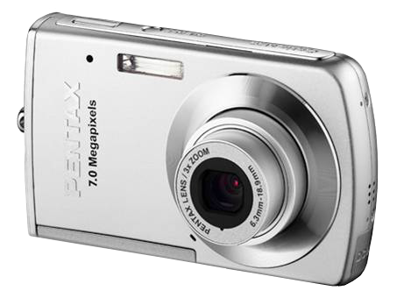
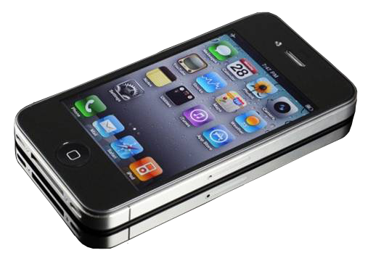
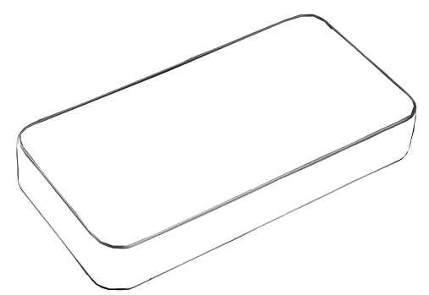
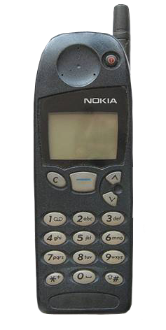
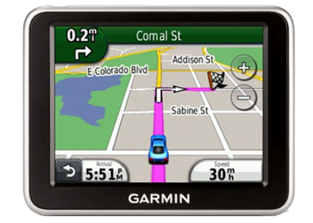
Yesterday

Slide 5
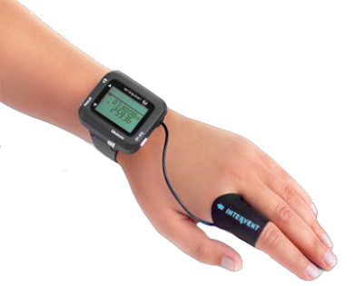
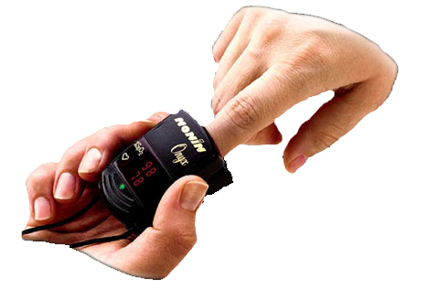
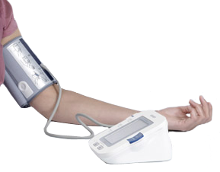
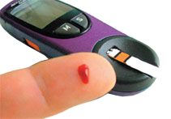
Today & Tomorrow

Slide 6
The Problem
Trans-continental Cyber attack on Pace-maker
Yesterday’s Murder - Attacker and victim in same location
State-of-the-art Murder
Embedded Systems are NO MORE isolated from Internet.
For eg. IoT devices
Opens a huge area of prime importance – Security.

Slide 7
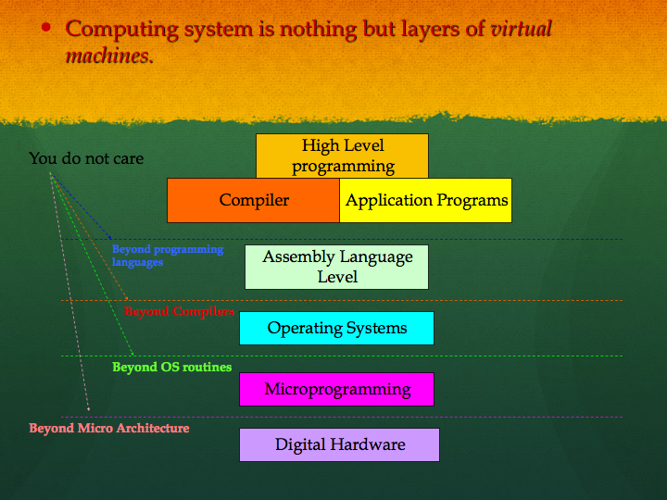
Embedded Systems Security

Slide 8
End of Session-1 Thank You

